Slide 1
SHARPFRIDGE :
Intelligent Refrigerator System
SHARPFRIDGE is a smart refrigerator system that increases the freshness and durability of food items by providing optimal storage conditions. This system aims to reduce food waste and minimize environmental impact by providing real-time monitoring and alerts.

Slide 2



OBJECTIVES
REAL-TIME ALERTS AND NOTIFICATIONS: IMPLEMENT A SYSTEM TO INFORM USERS OF ANY DEVIATIONS FROM OPTIMAL STORAGE CONDITIONS.
FRESHNESS AND LONGEVITY: MAİNTAİN OPTİMAL TEMPERATURE AND HUMIDITY LEVELS TO PRESERVE THE FRESHNESSAND EXTEND THE SHELF LIFE OF STORED FOOD.
USER-FRIENDLY INTERFACE: PROVIDE AN INTUITIVE INTERFACE FOR EASY MONITORING AND CONTROL OF THE REFRIGERATOR SYSTEM.
THOROUGH TESTING AND VALIDATION: ENSURE THE SYSTEM'S RELIABILITY AND EFFECTIVENESS THROUGH COMPREHENSİVE TESTING.
MULTI-USER ACCESS: ALLOW MULTIPLE USERS TO ACCESS AND MANAGE THE SYSTEM SIMULTANEOUSLY.
ACCURATE STORAGE PERİOD DETERMİNATİON: DETERMINE STORAGE PERIODS BASED ON THE FOOD PRODUCTİON AND CONSUMPTION DATES ENTERED BY USERS.
CUSTOMIZABLE COMPARTMENTS: ENABLE USERS TO SET DIFFERENT COMPARTMENTS WITH ADJUSTABLE TEMPERATURE AND HUMIDITY LEVELS TAILORED TO EACH TYPE OF FOOD

Slide 3
• System shall allow users to monitor temperature, humidity , storage levels and status of food with using sensor.
• System shall notify the user about optimal storage conditions via the user-friendly interface.
• Alerts shall give information about the affected
compartment and the deviation in the values that should be.
• The system shall adjust cooling and humidity levels based on the type of food that stored and environmental conditions.
• The cooling and humidity adjustments shall be automatically by the system without user intervention.
• The users shall be able to easily adjust settings for each
different compartments and food types.
• The system shall undergo rigorous testing to ensure reliability and effectiveness in maintaining optimal storage conditions.
• The system should recalculate humidity and temperatures
after a power outage.
Functional Requirements

Slide 4
The system shall operate reliably under varying environmental conditions.
The system shall have fail-safe mechanisms to prevent spoilage in case of sensor failure or power outage.
User data, including login credentials and food storage information, shall be encrypted and securely stored.
Access to sensitive features such as temperature adjustment shall be restricted to authorized users.
The system architecture shall support scalability to accommodate additional sensors or features in future upgrades.
Instructions and help resources shall be available within the interface for user assistance.
The system shall be compatible with a wide range of food storage containers and packaging materials.
The user interface shall be intuitive and easy to navigate, requiring minimal training for users.
Non- Functional Requirements

Slide 5
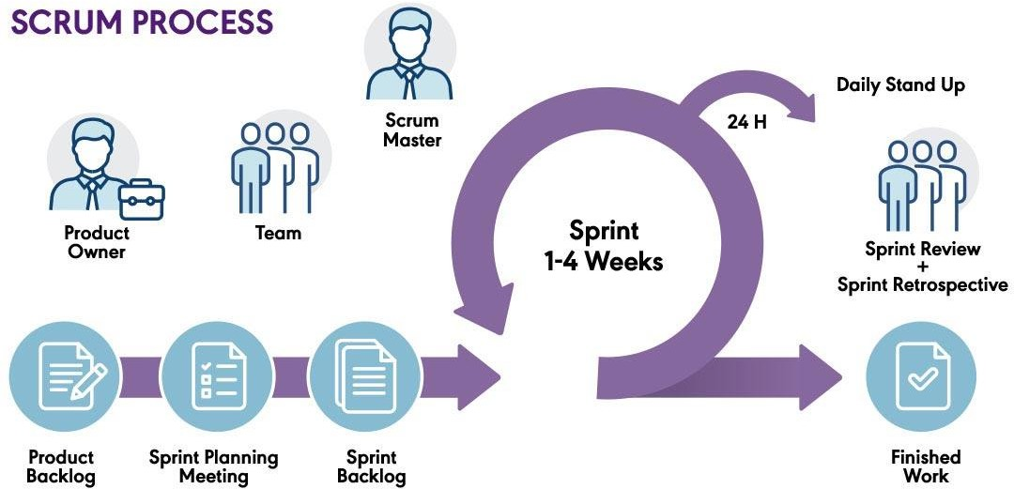
Software
Process Model
Reason to Choose This Model
In this application hardware is necessary, creating prototypes is essential. Scrum enables us to develop and test prototypes.
SharpFridge has both software and hardware
development. Scrum supports -
functional teams to work together effectively.
Scrum makes customers actively involved throughout the project, providing feedback at every stage.
Scrum minimizes these costs by promoting , feedback regularly, allowing the project to adapt to technological advances and changes. It includes daily standup meetings and regular sprint reviews.
They are essential in communication.

Slide 6
MEASUREMENTS
Effort: Total person hours spent on development and testing.
Schedule Compliance: Compared to the Gantt chart and predicted resources.
Code Reuse: Percentage of automated or finished tasks via pre-written code or libraries. (E.g. using libnet in order to send packages)
Number of Changes: Rate of changes made and ongoing changes.
Product Quality: Combination of defects(mismatches),errors and bugs.
Testing effort: Time, budget and workforce allocated to test the components.
Product Size: Number of components, required documentation size, training material, embedded software size in bytes.
Data management: Cost and length of completed sprints/Estimated amount for all sprints.

Slide 7
Additional Software Tools: Notification Services
Tool | Amazon SQS | Redis | Firebase
Cost | $1,552.42/mo | $600/mo | $450/mo
Training Days Functionality | 10 | 7 | 23
 | 90 | 50 | 40
Services for Push Notifications
Cost Training Days Functionality
Firebase
Tool | Amazon SQS | Redis | Firebase
Cost Training Days | 100 | 38.7 | 29.0
 | 43.5 | 30.4 | 100
Functionality | 100 | 55.5 | 44.4
Redis
Amazon SQS
Amazon SQS is selected due to
Integration with DynamoDB
Integration with Django Celery
Flexible and robust
0.00
50.00
100.00
150.00
200.00
250.00
300.00

Slide 8
Additional Software Tools: Database
Database Systems
Tool | MongoDB | MariaDB | Oracle | DynamoDB
Cost | $300/Mo | $430/Mo | $460/Mo | $930/Mo
Training Days | 3 | 5 | 7 | 8
Functionality | 70 | 40 | 60 | 80
Tool | MongoDB | MariaDB | Oracle | DynamoDB
Cost | 32.2 | 46.2 | 49.4 | 100
Training Days | 37.5 | 62.5 | 87.5 | 100
Functionality | 87.5 50 |  | 75 | 100
Amazon DynamoDB
Oracle
MariaDB
MongoDB
Amazon DynamoDB is selected due to
0.00
50.00 100.00 150.00 200.00 250.00 300.00 350.00
Cost
Best performance in high traffic
Globally distributed servers
Training Days
Functionality

Slide 9
Additional Software Tools: Project Management
Tool Asana Trello Jira
Cost | $250/Mo | $175/Mo | $160/Mo
Training Days | 1 | 1 | 5
Functionality | 70 | 60 | 80
Tool | Asana Trello Jira
Cost | 100 | 70 | 64
Training Days | 20 | 20 | 100
Functionality | 87.5 | 75 | 100
Task Management Tools
Jira
Trello
Asana
Jira is selected due to
Low cost
Agile development support
0.00
50.00
100.00 150.00
Cost Training Days
200.00
Functionality
250.00
300.00

Slide 10
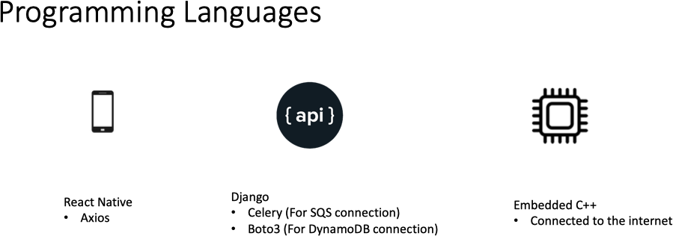

Slide 11
STAKEHOLDERS

Slide 12
# | ST AKEHOL DERS | DESCRIPTION
1 | Chain Restaurant Owners/Managers | They are the primary stakeholders as they are directly impacted by the inefficiencies of traditional refrigeration systems economically.
2 | Restaurant and Kitchen Staff | They interact directly with the refrigerator system on a daily basis. They are the group that benefits most from the system's interface and functionality to food storage and retrieval processes.
3 | Customers of the Restaurant | Indirectly impacted by the quality of food served at restaurants. Because of the freshness and quality of the food items stored in the refrigerator system affects their dining experience, they are also stakeholders.
4 | Environmental Conservation Organizations | They are concerned with reducing food waste and minimizing environmental impact. The effectiveness of the intelligent refrigerator system help to reduce food waste and promote sustainable practices.
5 | Suppliers/Vendors | Since they are provide food items to chain restaurants, the food items they supply must be stored properly and maintain their quality. Therefore, it minimizes losses for both parties.

Slide 13
# | STAKEHOLDERS | DESCRIPTION
6 | Regulatory Authorities | Their role involves guaranteeing adherence to food safety and storage guidelines, while smart refrigerator systems aid chains in ensuring food safety.
7 | Technology Providers | Firms specializing in sensor technology generate revenue through the creation of software development tools and other technical elements. The enhanced value of their technology occurs with the effective integration and widespread acceptance within intelligent refrigerator systems.
8 | Competitors | Competitors encompass a range of firms working on similar intelligent refrigeration systems or alternative solutions to tackle inefficiencies in food storage, including developers of conventional refrigerators. The responses and strategies of SharpFridge could potentially steer the course and marketing approaches of these other companies.
9 | Developers of SharpFridge | As they allocate their workforce and budget towards this project, the sales performance and maintenance of SharpFridge can significantly influence their branding and contribute to the expansion of their company.

Slide 14
RISKS
LIKELIHOOD RANK | IMPACT RANK | COMBINED RANK | RISKS
1 | 1 | 2 | Security Breaches
5 | 2 | 7 | Hardware Supply Chain Disruptions
2 | 7 | 9 | Inaccurate Sensor Readings
7 | 3 | 10 | Technical Failures
6 | 4 | 10 | Regulatory Changes
3 | 8 | 11 | Compatibility Issues
4 | 9 | 13 | Insufficient User Training
8 | 5 | 13 | Competition
10 | 6 | 16 | Budget Constraints
6 | 10 | 16 | Consumer Shifts

Slide 15
SOFTWARE NEEDS
HARDWARE NEEDS
SUPPORT NEEDS
Operating System Application Software Networking Software Firmware Analytics and Reporting Software Integration Software | Sensors Cooling System User Interface Communication Equipment Supporting Equipment Data Storage Environmental Monitoring Equipment Power Management Physical Infrastructure Safety Features | Technical Support Procurement Support IT Support Training and Education Maintenance and Service Regulatory Compliance Support

Slide 16
Project Schedule

Slide 17
Project Planning and Controlling
Duration : 22 Days
Project Scope Definiton
Stakeholder Analysis
Budget Management
Risk Assessment
Creating Project Schedule
Critical activities: defining project scope, stakeholder analysis, budget management, risk assessment, and creating the project schedule.

Slide 18
Hardware
Duration : 14 Days
Identifying Extra Requirements
Vendor Proposal Analysis
Evaluation and Vendor Selection
Procurement
We focus on identifying extra requirements, analyzing vendor proposals, and conducting procurement. These steps are vital to ensure that we have the right components for the project's hardware needs.

Slide 19
Sensor Integration
Duration : 28 Days
Sensor Quality Selection
Physical Installation
Sensor Prototyping
Developing Low-Level Software
Integration with Low-Level Software
Extensive phase ensuring sensor functionality and integration.
Tasks: sensor quality selection, physical installation, prototyping, developing and integrating low-level software.

Slide 20
User App Design
Focus on creating a user- friendly application.
Includes UX design, backend development, visual design, prototyping, and usability testing.
Duration : 14 Days
UX Design
Backend Development
Visual Design
Prototyping
Usability Testing

Slide 21
Testing and Validation
Duration : 24 Days
Test Planning
Test Execution
Defect Tracking
Validation
User Acceptance Testing
Ensuring product quality and reliability.
Involves test planning, execution, defect tracking, validation, and user acceptance testing.

Slide 22
Documentation and Deployment
Duration :
14 Days(documentation)
7 Days(deployment)
Training Guide
Training Courses
Deployment
Monitoring and Support
Documentation: user manuals, technical specifications, installation and training guides.
Deployment: training courses, software deployment, monitoring, and support.

Slide 23
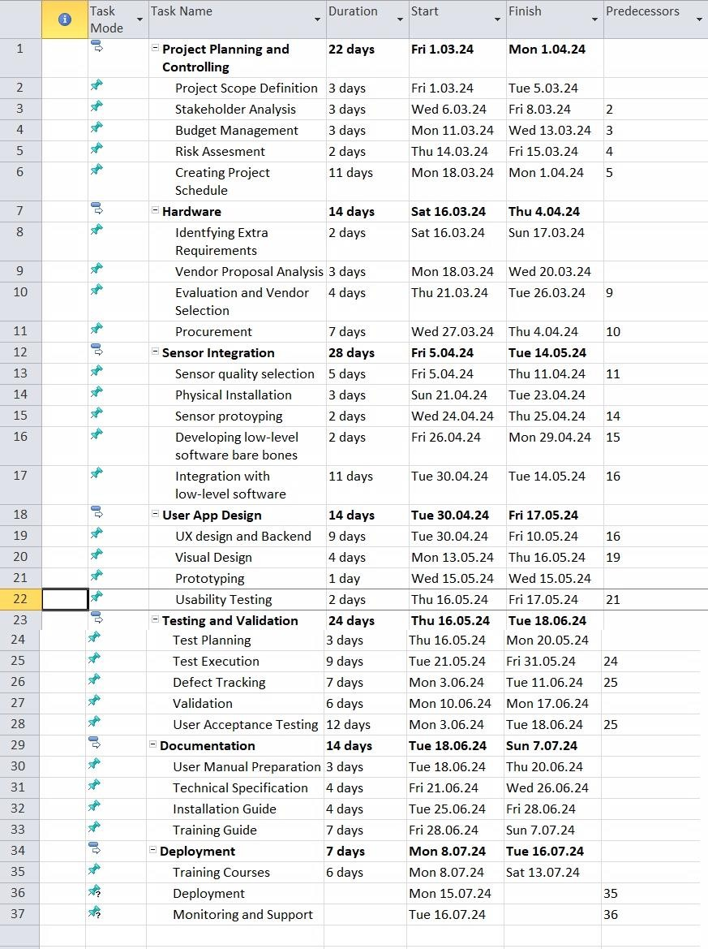
Gantt Chart and Schedule

Slide 24
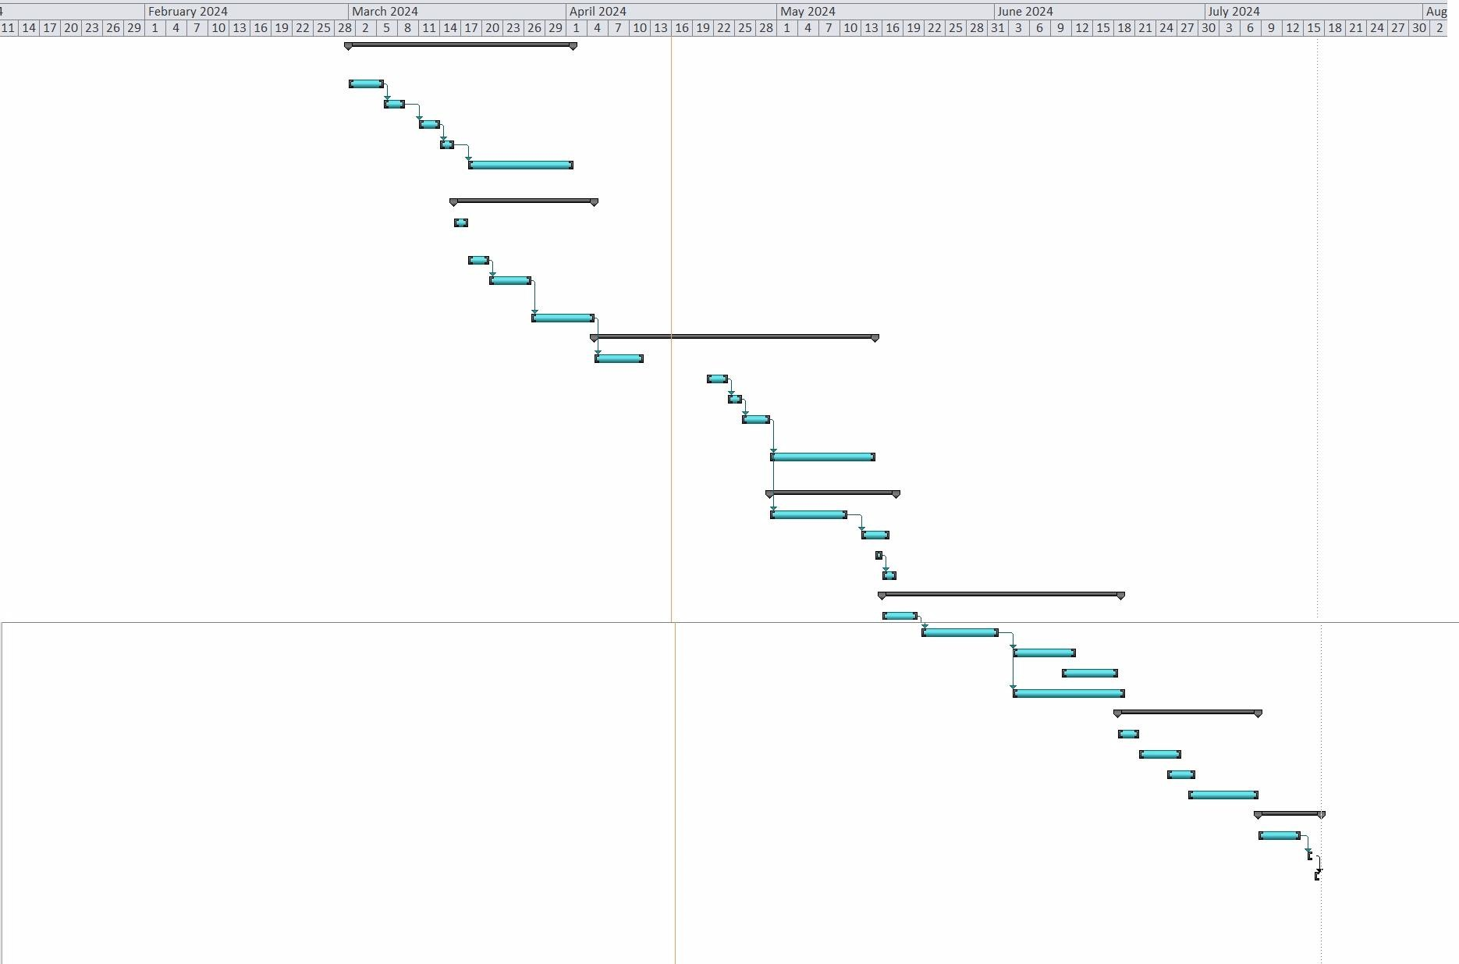
Gantt Chart and Schedule

